Slide 1
Cramer-Rao Inequality
Session 9
27/03/2021

Slide 2

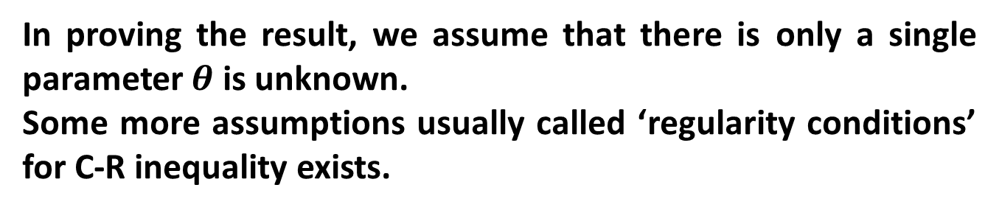
Cramer-Rao Inequality
If $t$ is an unbiased estimator of $γ\left(θ\right)$, a function of parameter $θ$, then
$$Var\left(t\right)≥\frac{{\left\{\frac{d}{dθ}γ\left(θ\right)\right\}}^{2}}{{E\left(\frac{∂}{∂θ}logL\right)}^{2}}=\frac{{\left\{γ^{′}\left(θ\right)\right\}}^{2}}{I\left(θ\right)}…(1)$$
where $I\left(θ\right)$ is the information on $θ,$supplied by the sample.
In proving the result, we assume that there is only a single parameter $θ$ is unknown.
Some more assumptions usually called ‘regularity conditions’ for C-R inequality exists.

Slide 3
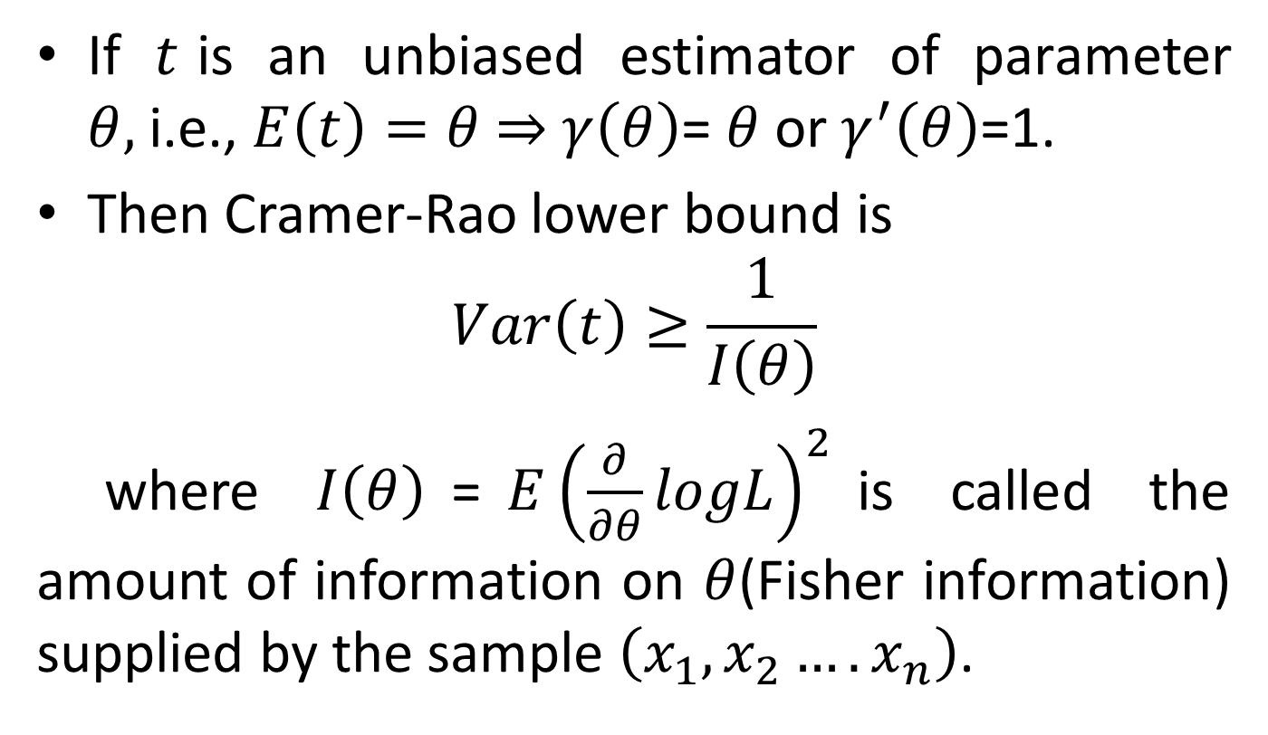
Corrollory
If $t$is an unbiased estimator of parameter $θ,$i.e., $E\left(t\right)=θ$ $⇒$ $γ\left(θ\right)$= $θ$ or $γ^{′}\left(θ\right)$=1.
Then Cramer-Rao lower bound is
$$Var\left(t\right)≥\frac{1}{I\left(θ\right)}$$
where $I\left(θ\right)$=${E\left(\frac{∂}{∂θ}logL\right)}^{2}$is called the amount of information on $θ$(Fisher information) supplied by the sample $\left(x_{1},x_{2}….x_{n}\right)$.

Slide 4

Minimum Variance Bound estimator
An unbiased estimator $t$ of $γ\left(θ\right)$ for which Cramer-Rao lower bound is attained is called a minimum variance bound estimator.

Slide 5
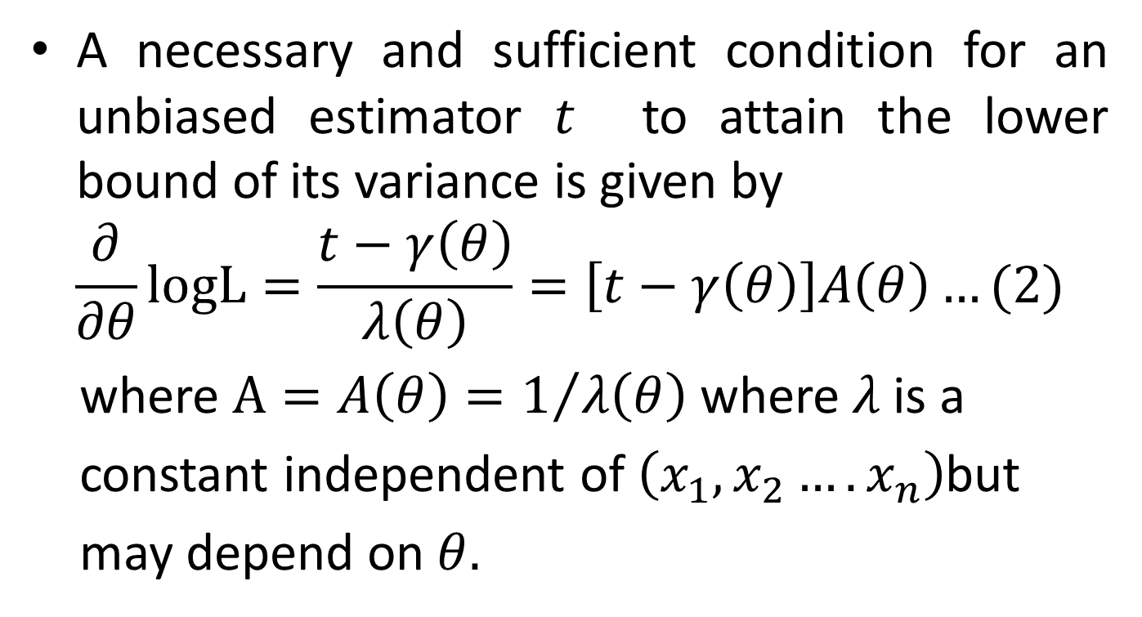
Conditions for equality sign in Cramer-Rao Inequality
A necessary and sufficient condition for an unbiased estimator $t$ to attain the lower bound of its variance is given by
$$\frac{∂}{∂θ}logL=\frac{t−γ\left(θ\right)}{λ\left(θ\right)}=\left[t−γ\left(θ\right)\right]A\left(θ\right)…(2)$$
where $A=A\left(θ\right)=1/{λ\left(θ\right)}$ where $λ$is a
constant independent of $\left(x_{1},x_{2}….x_{n}\right)$but
may depend on $θ.$

Slide 6
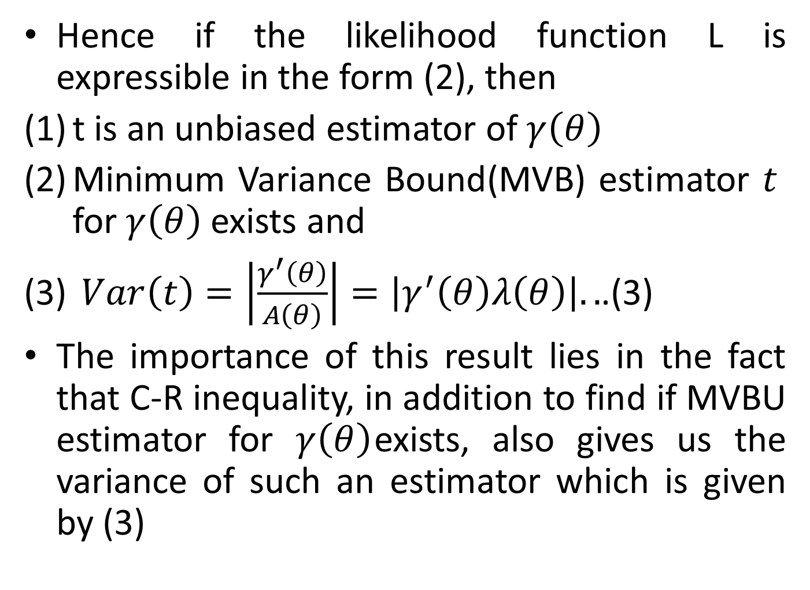
Hence if the likelihood function L is expressible in the form (2), then
t is an unbiased estimator of $γ\left(θ\right)$
Minimum Variance Bound(MVB) estimator $t$ for $γ\left(θ\right)$ exists and
$Var\left(t\right)=\left|\frac{γ^{′}\left(θ\right)}{A\left(θ\right)}\right|=\left|γ^{′}\left(θ\right)λ\left(θ\right)\right|..$.(3)
The importance of this result lies in the fact that C-R inequality, in addition to find if MVBU estimator for $γ\left(θ\right)$exists, also gives us the variance of such an estimator which is given by (3)

Slide 7
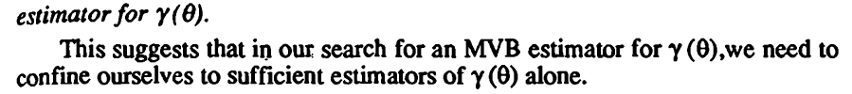
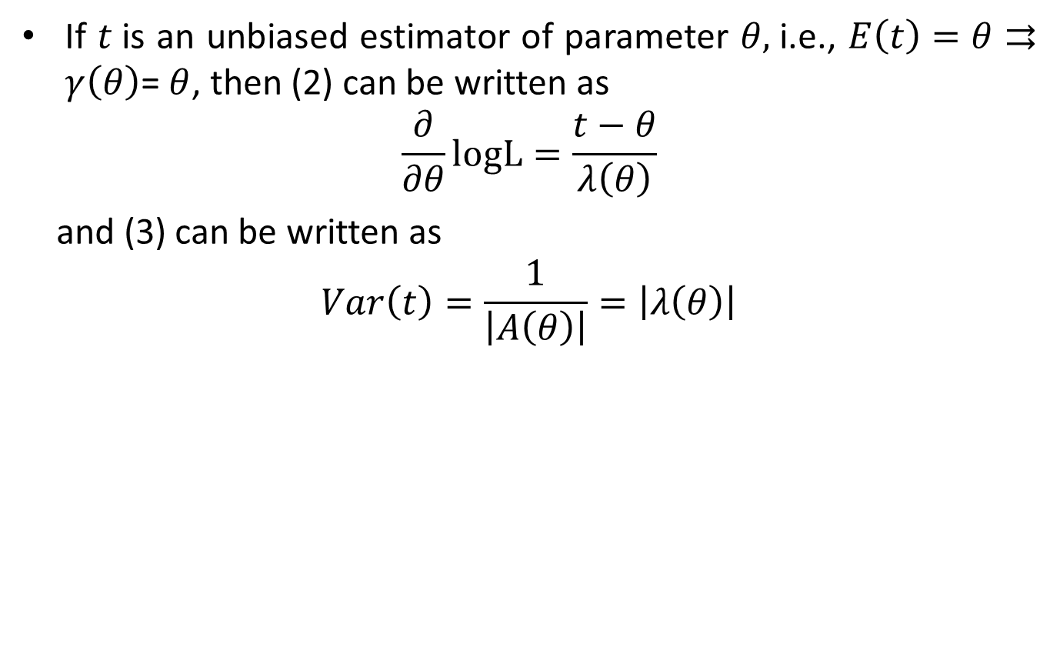
Remarks
If $t$is an unbiased estimator of parameter $θ,$i.e., $E\left(t\right)=θ⇉$ $γ\left(θ\right)$= $θ$, then (2) can be written as
$$\frac{∂}{∂θ}logL=\frac{t−θ}{λ\left(θ\right)}$$
and (3) can be written as
$$Var\left(t\right)=\frac{1}{\left|A\left(θ\right)\right|}=\left|λ\left(θ\right)\right|$$

Slide 8
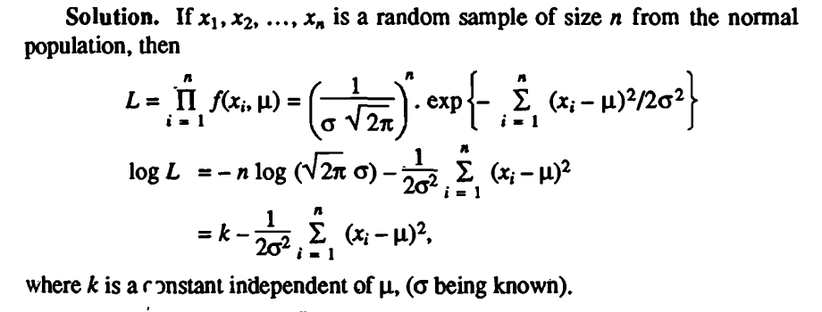
Example 1

Slide 9
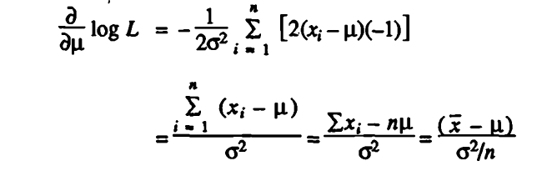
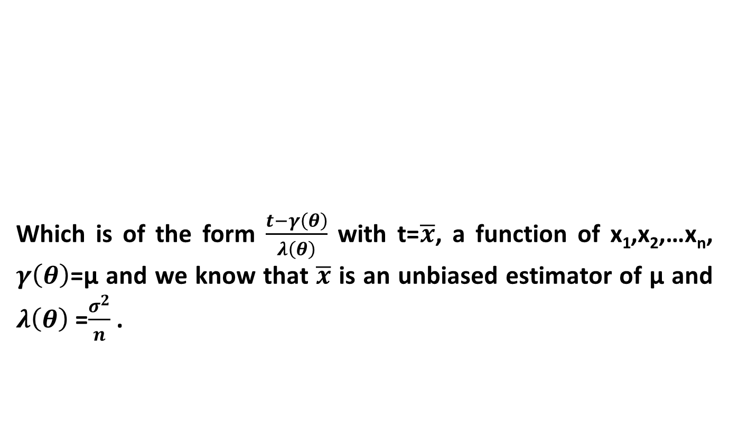
Example 1 (contd…)
Which is of the form $\frac{t−γ\left(θ\right)}{λ\left(θ\right)}$ with t=$\overline{x}$, a function of x₁,x₂,…x_{n}, $γ\left(θ\right)$=μ and we know that $\overline{x}$ is an unbiased estimator of μ and $λ\left(θ\right)$ =$\frac{σ^{2}}{n}$ .

Slide 10

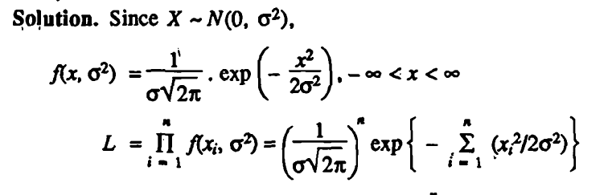

Example 2
Example 2 :

Slide 11
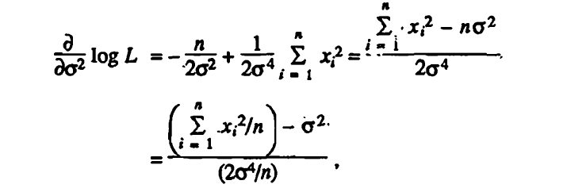

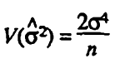

Example 2
Which is of the form $\frac{t−γ\left(θ\right)}{λ\left(θ\right)}$ with t= $\frac{\sum_{i=1}^{n}{{x_{i}}^{2}}}{n}$, a function of x₁,x₂,…x_{n}, $γ\left(θ\right)$=$σ^{2}$ and $λ\left(θ\right)$ =$\frac{{2σ}^{4}}{n}$ .

Slide 12



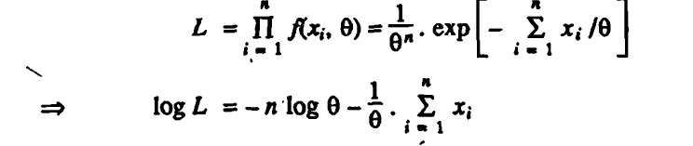
Example 3

Slide 13
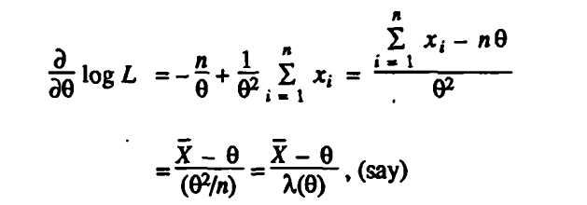

Example 3 (contd…)
Which is of the form $\frac{t−γ\left(θ\right)}{λ\left(θ\right)}$ with t= $\overline{X}$, a function of x₁,x₂,…x_{n}, $γ\left(θ\right)$= $θ$ and $λ\left(θ\right)$ =$\frac{θ^{2}}{n}$ .

